Slide 1
Object Identification APp
Android app that classifies image (object/s) using googles’ TensorFlow-lite library to identify given object via live feed camera or captured still image.
S-ITC539-201960-SI | Assignment 4 | Demo and Presentation
Submitted to: Dr. Robin GAO |Submitted by: Sarthak Joshi (11678187)

Slide 2
Roadmap to this presentation
Overview of application
Self/App Introductions
Implemented Features
Platform target and why it was chosen
Interesting tools and techniques
Major challenges and success
Improvements in the future
App Technical Discussion
Run inference model with TensorFlow Lite Library
Capture Image with Camera API2
Class diagram that demonstrate the code’s functionality
App Demonstration
Use case Scenarios with Screenshots
Video demonstration

Slide 3
Overview of application

Slide 4
Self-introduction and introduction of the app
I’m Sarthak Joshi, an MIT student here at Charles Sturt University, Sydney.
Basically, major feature of this app is to identify objects through image or live camera feed, using TensforFlow-Lite, a Machine Learning and Deep Learning library provided by Google.

Slide 5
Implemented features
User is able to select Float or Quantized Model to run the classification.
Model essentially is a pattern formed from chunks of training data, such that the input values corresponds to the target (here, for instance, “object”).
Take still picture through device camera and identify the still picture’s object.
Live object detection with live feed from the device camera.

Slide 6
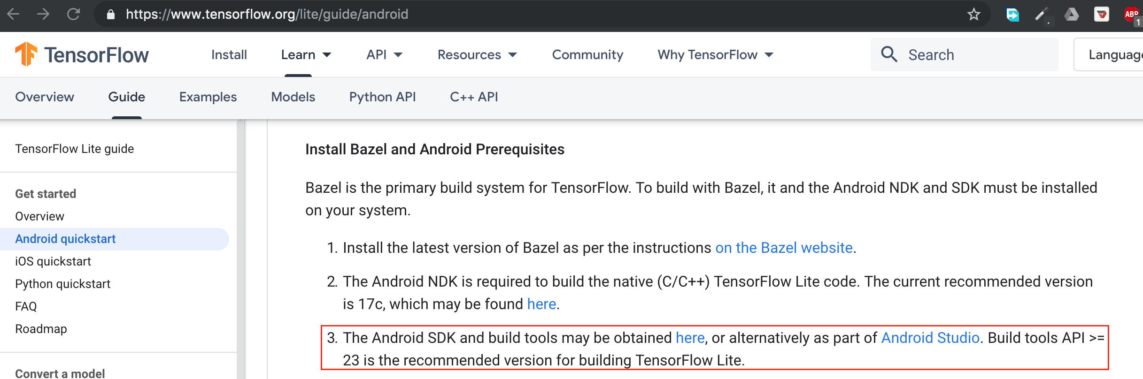
Platform target and why it was chosen
Target chosen: 29
Minimum target: 23
The reason behind choosing platform targets minimum 23 and latest 29 is that TensorFlow Lite recommends at least there version for building TensorFlow Lite integrated application.

Slide 7
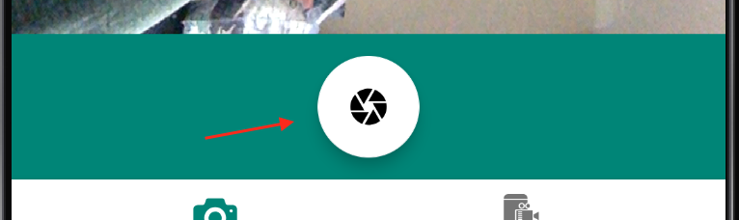
Interesting tools and techniques
Material UI is a design tool provided by Google. I used this tool to create fancy icon for image capture action.
TensorFlow Lite provided by Google: Provides different Machine learning algorithms and deep learning techniques such as Convolutional Neural Network out of the box.

Slide 8
Major challenges and success
Finding good image classification library: There was a hard time to finding the best image classification library and model to fit in this app. Fortunately, TensorFlow Lite filled all the gaps and requirements.
Camera API2: For this app, I decided to use Camera API2 which has lots of new features compared to Camera API1. But at the same time, there was not enough or easy to follow documentation regrading Camera API2. After digging for many hours, I was finally able to work with Camera API2.

Slide 9
Improvements is the future
Within a short period of time, I believe that I’m proud of myself to complete this project meeting the given requirements. Whatsoever, I feel there are some gaps to fill to make this app more useful. This app is used to classify the images and object but this technique could be implemented in different types of field. For instance, for self-driving car like “Tesla car”, “object identification” technique is very essential to prevent from accidents and to provide a safe driving experience.

Slide 10
App Technical Discussion

Slide 11
Run inference model with TensorFlow Lite Library
Running inference (“identification”) actually happens when user captures still image and hit Classify button (on next activity of the app) or selects option “Live Image Classification” bottom navigation menu. It means that, app begins to identify object through device camera and displays the top three predictions on the screen.
Say, user has chosen Quantized Model to run the classification.

Slide 12
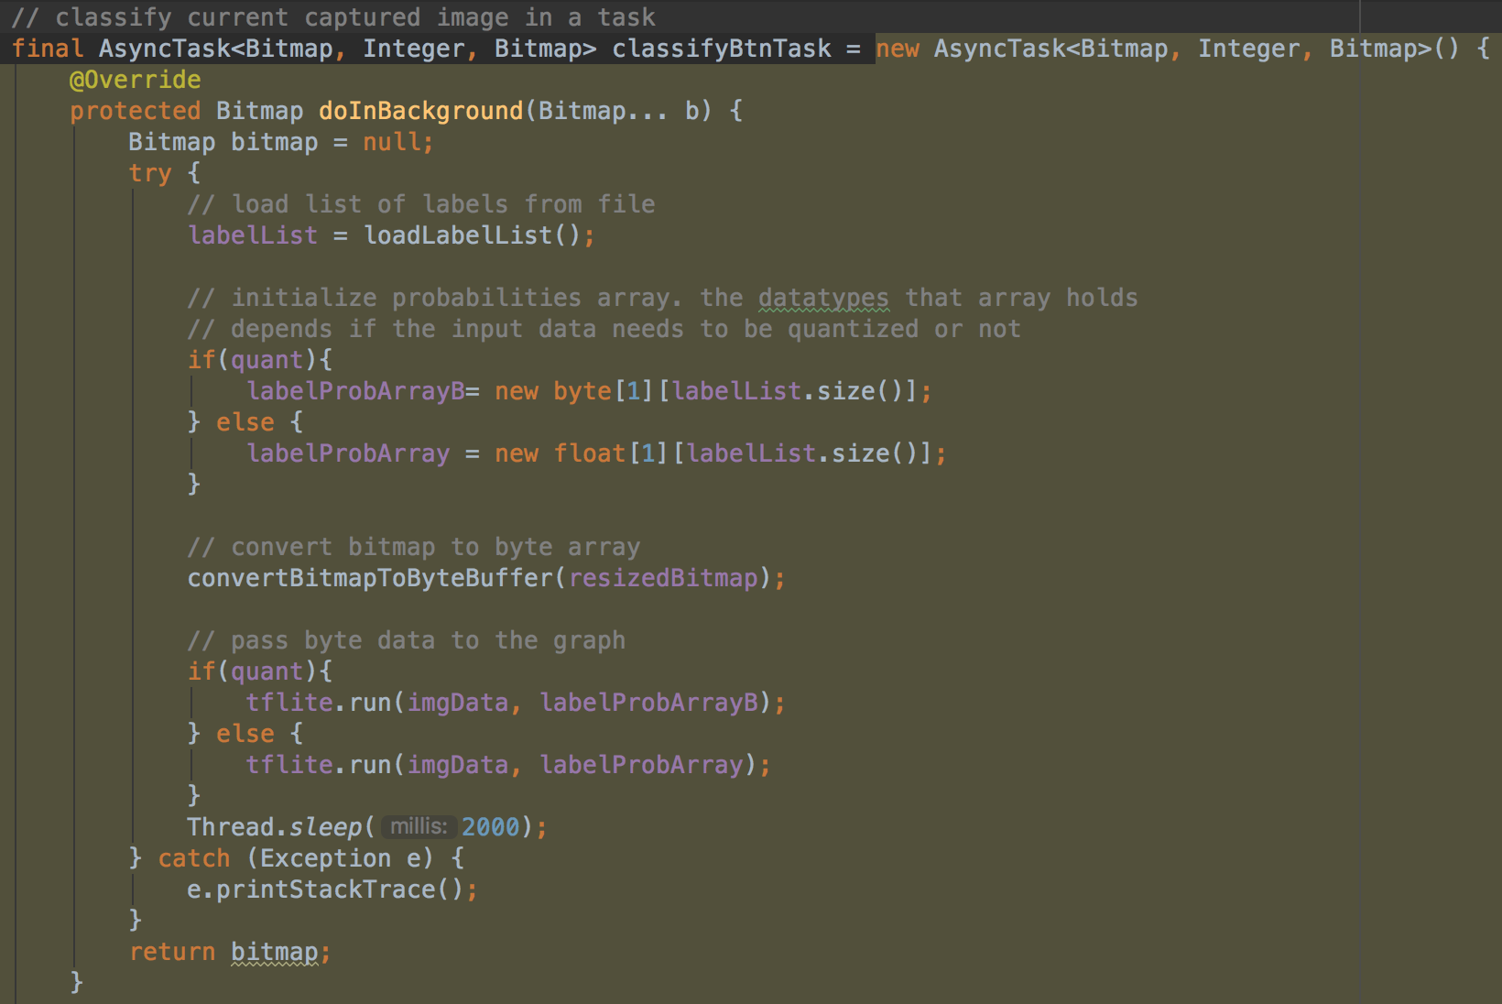
When user click Classify button or jumps to Live Image Classification features, classifyBtnTask is executed and process several synchronous task in asynchronous manner.

Slide 13
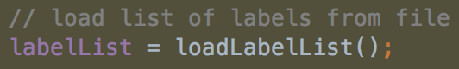
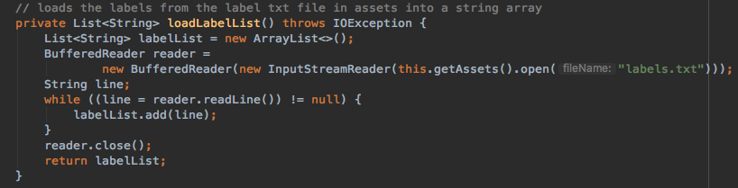
First off, it loads list of predefined labels by calling loadLabelList() function and storing the labels in List objects called lableList. Labels are essentially names of objects which are identified and stored into pretrained model provided by TensorFlow Lite.
LoadLabelList function:

Slide 14
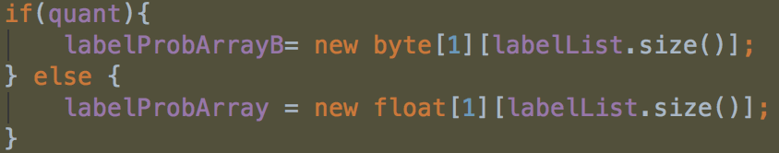
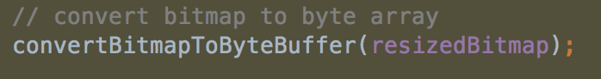
After, the programs check the user chosen option for quant model or float model. If it is quant model, byte 2d-array object labelProbArrayB will hold the probabilities of each label for quantized graphs. And for float, labelProbArray is used.
Then program converts resized image bitmap to byte buffer.
But before this process, several tasks are carried out. When user captures the image, that image is converted to Bitmap object. That bitmap object gets resized in order to meet TensorFlow lite’s image size requirement.

Slide 15
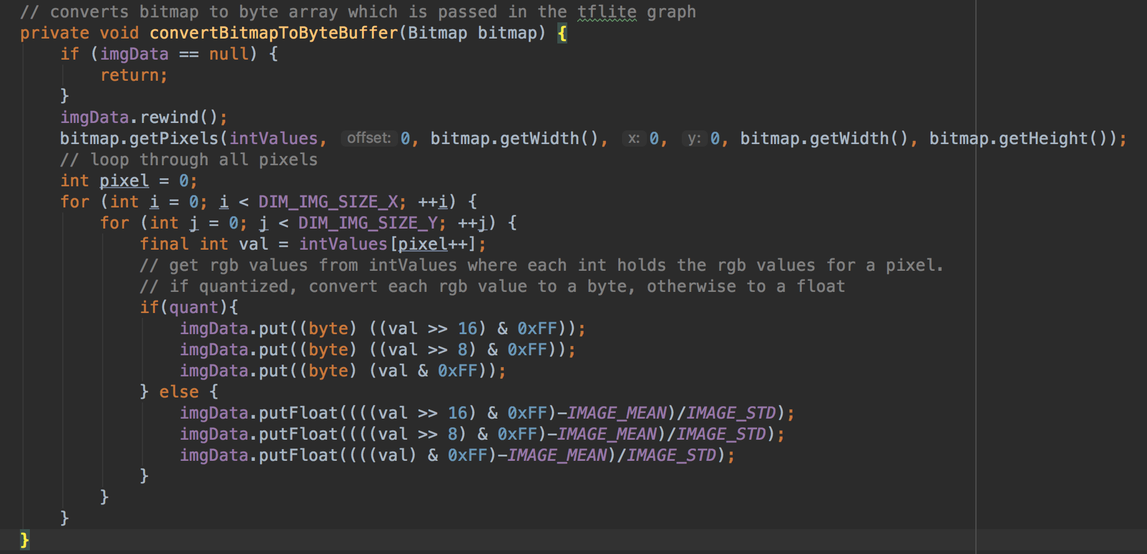
Converting bitmap to byte array
In high level understanding, TensorFlow Lite or any other image classification process convert image to bitmap and converts bitmap to byte buffer. This is done in order to loop through each pixels of the image.

Slide 16
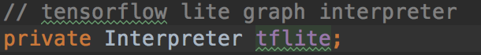
After all those process, Tensorflow lite’s Interpreter is executed.
Interpreter is a Class provided by TensorFlow Lite library that takes a model file, such as quantized model, then executes the operations it defines on input data and provides access to the target/output.
In this case, Interpreter is pre initialized with tflite object in the program.
Here, Interpreter takes two parameters:
list of labels (which we have discussed before)
Interpreter options (default options)

Slide 17
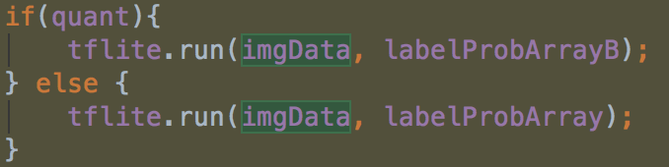
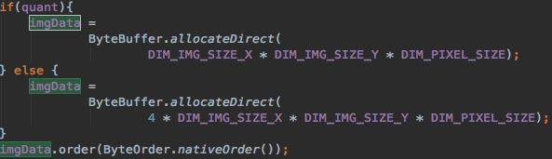
This Interpreter is executed in this same task, by calling tflite object.
Here, .run method takes two parameters:
imgData: is a bytebuffer that holds the image buffer size
DIM_IMG_SIZE_X * DIM_IMG_SIZE_Y * DIM_PIXEL_SIZE are the dimension given to captured image.
labelProbArray/B: holds the label’s probabilities for either quantized model or float model.

Slide 18
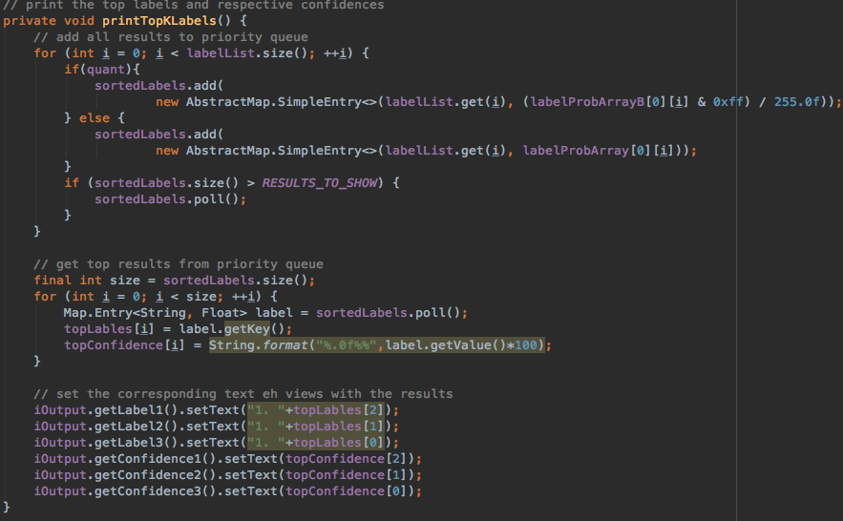
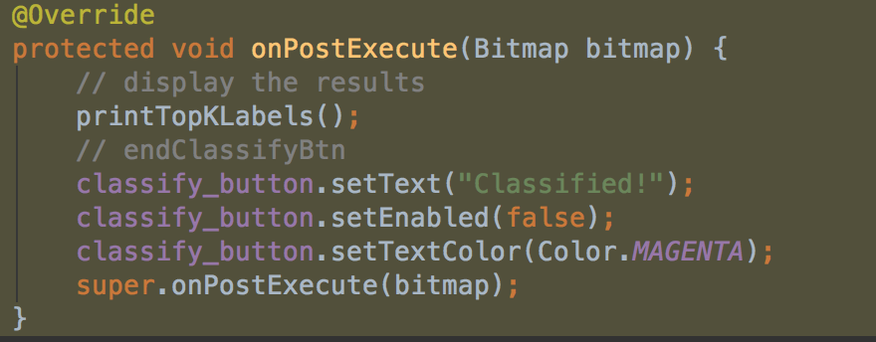
Finally, after the executing the Interperter, TensorFlow Lite starts to do it’s job to identify objects and identified object’s names are then display to the device screen by printTopKLabes() function, which is the last function of this major task.

Slide 19
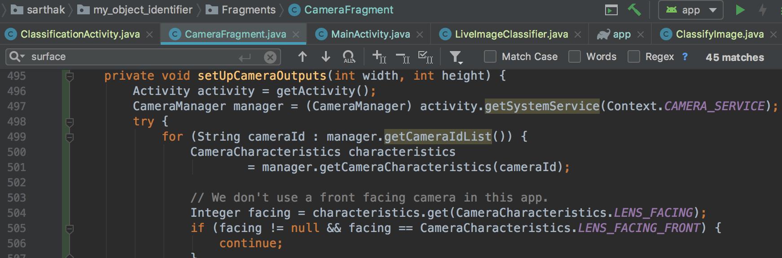
Capture Image with Camera API2
The obsolete Camera class is substituted by the android.hardware.camera2 package. It provides an interfaces to each camera unlike Camera class. Nowadays, we can see devices with multiple cameras. In such cases, Camera API2 open doors to every camera device.
To get the available Camera devices, CameraManager instance comes handy.

Slide 20
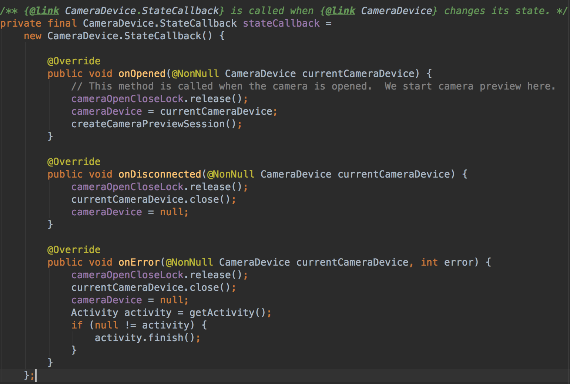
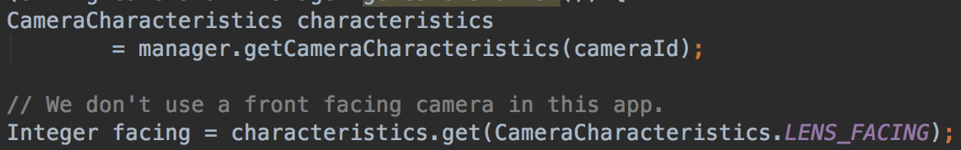
Specific CameraDevices provide a collection of standardized property data defining the device's hardware and usable system configurations and parameters. The CameraCharacteristics Object provides this information and it is available via getCameraCharacteristics (String).

Slide 21
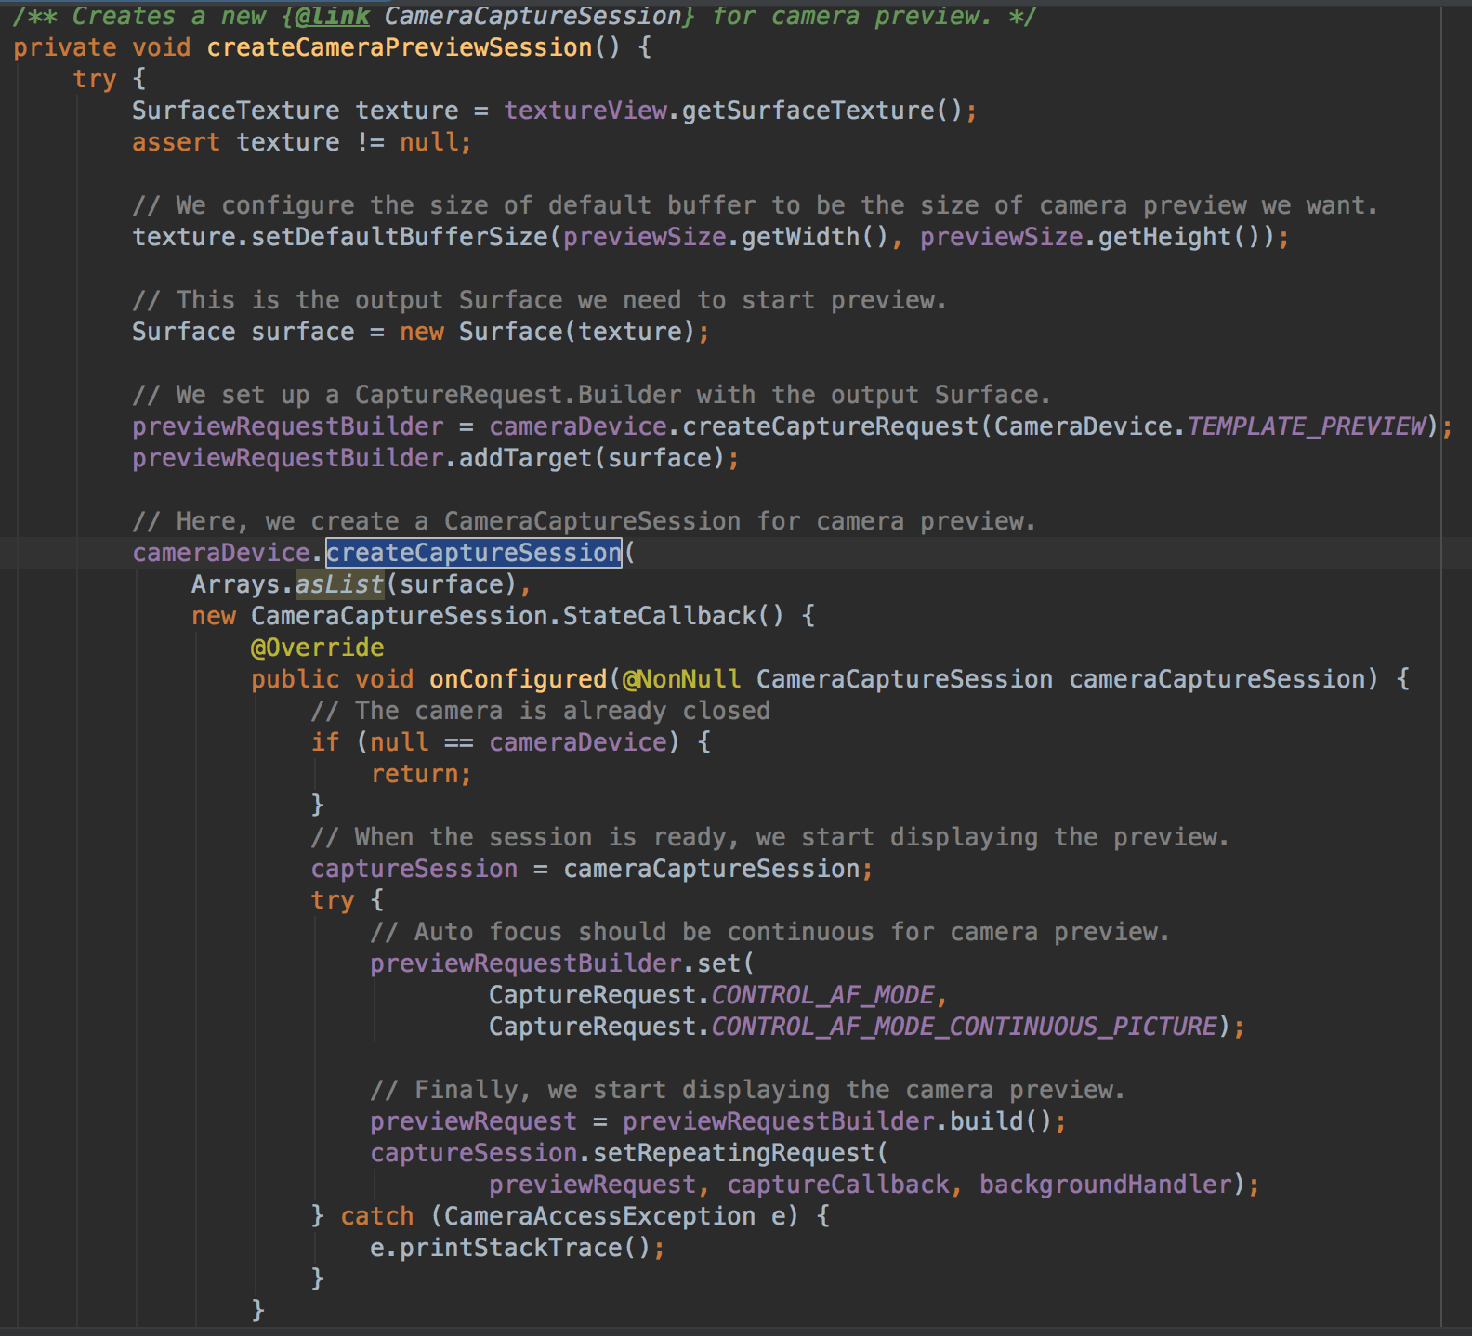
The app must first create a camera capture session with a collection for use with the camera system with output Surfaces with createCaptureSession(SessionConfiguration) to capture or stream picture from camera.

Slide 22
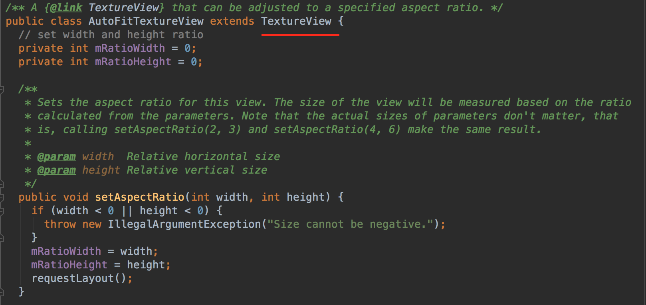
Surface must be preconfigured to suit the sizes and formats accessible from the camera unit, with the appropriate size and formats (if applicable). In general, camera view images (via its SurfaceTexture) are sent to SurfaceView or TextureView.

Slide 23
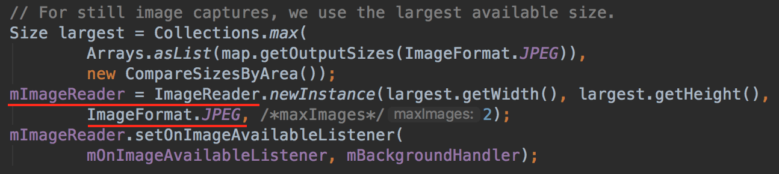
DngCreator can get JPEG images or RAW buffers with JPEG or RAW SENSOR formats using ImageReader.

Slide 24
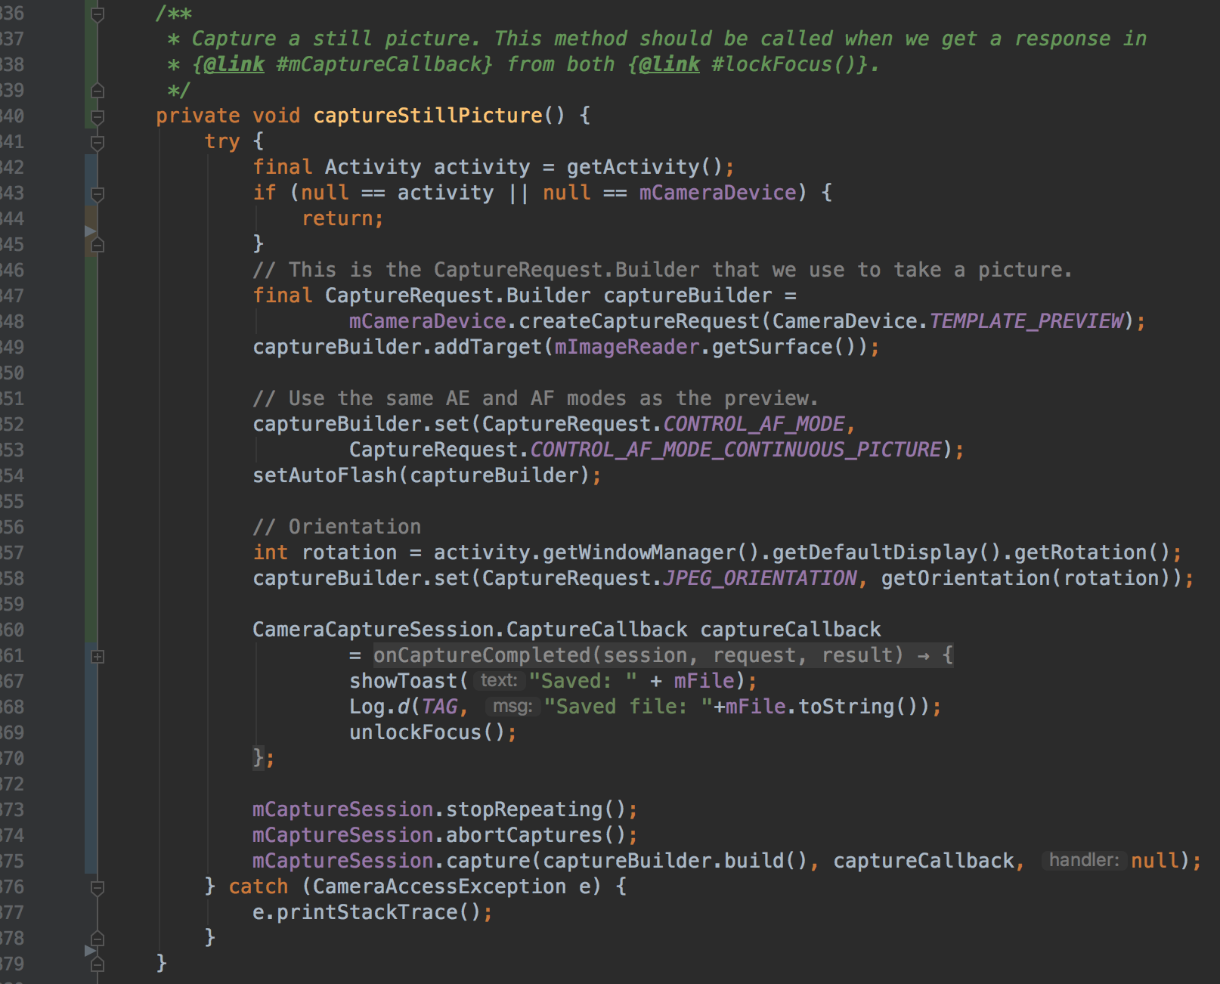
Finally, after opening camera devices, setting all the sessions and surfaces, dealing with permissions, we now can capture still images with captureStillPicture() function which is defined in this app source code.

Slide 25
Class diagram

Slide 26
App Demonstration

Slide 27
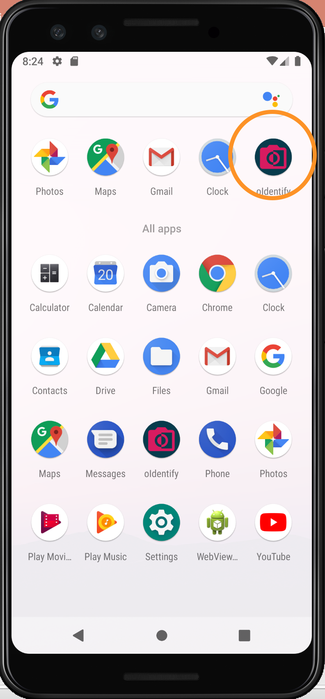
Use cases and screenshots
Open app

Slide 28
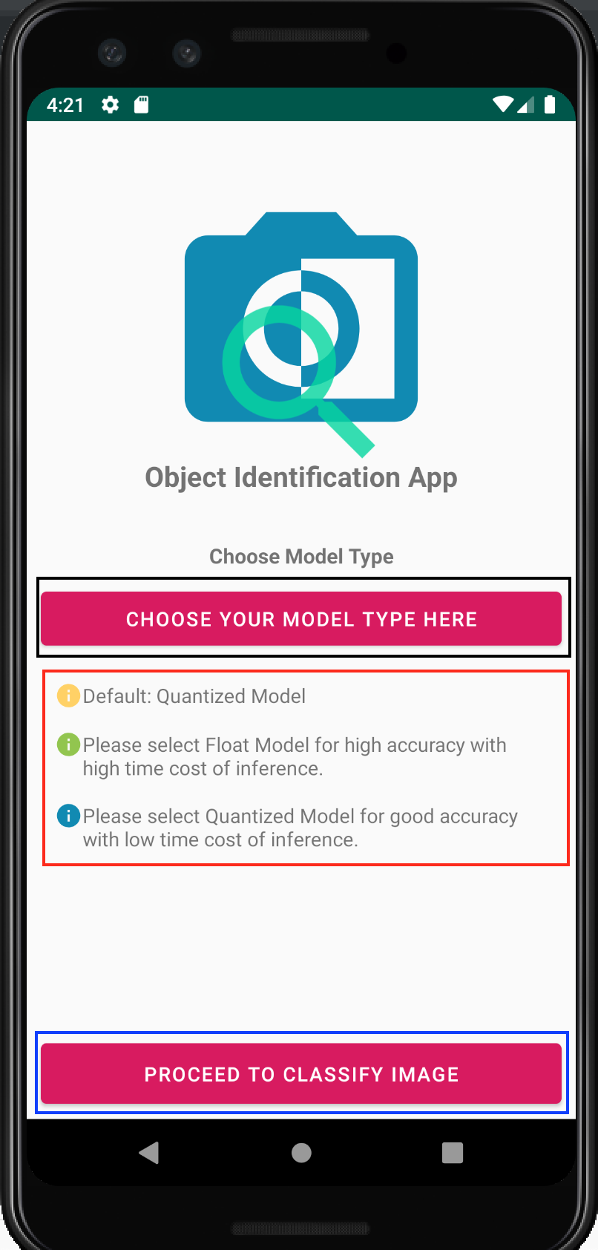
App launched (Home screen – Main Activity)

Slide 29
object Identification by taking still photo

Slide 30

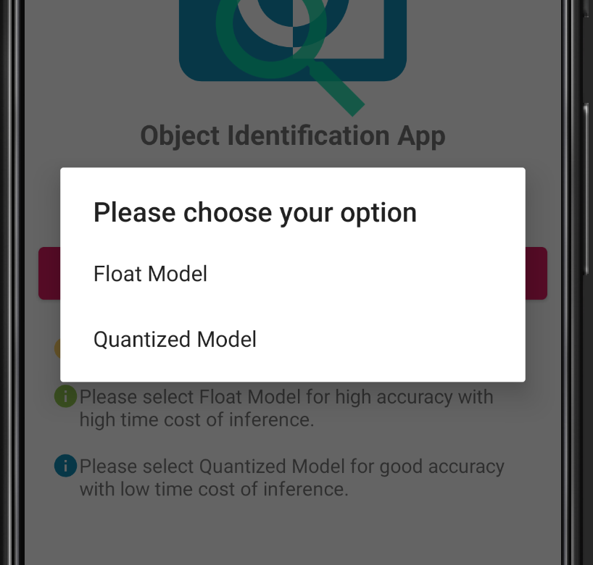
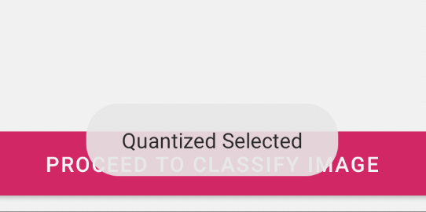
Choose model type:
Tapping on “CHOOSE YOU MODEL TYPE HERE” button, we get dialog box asking for user input.
A Toast message is displayed after selection has been done.

Slide 31

Proceed to classify image: We can now proceed to identify image by either capturing the image or live feeding image. We can procced by tapping on “PROCEED TO CLASSIFY IMAGE” button.

Slide 32
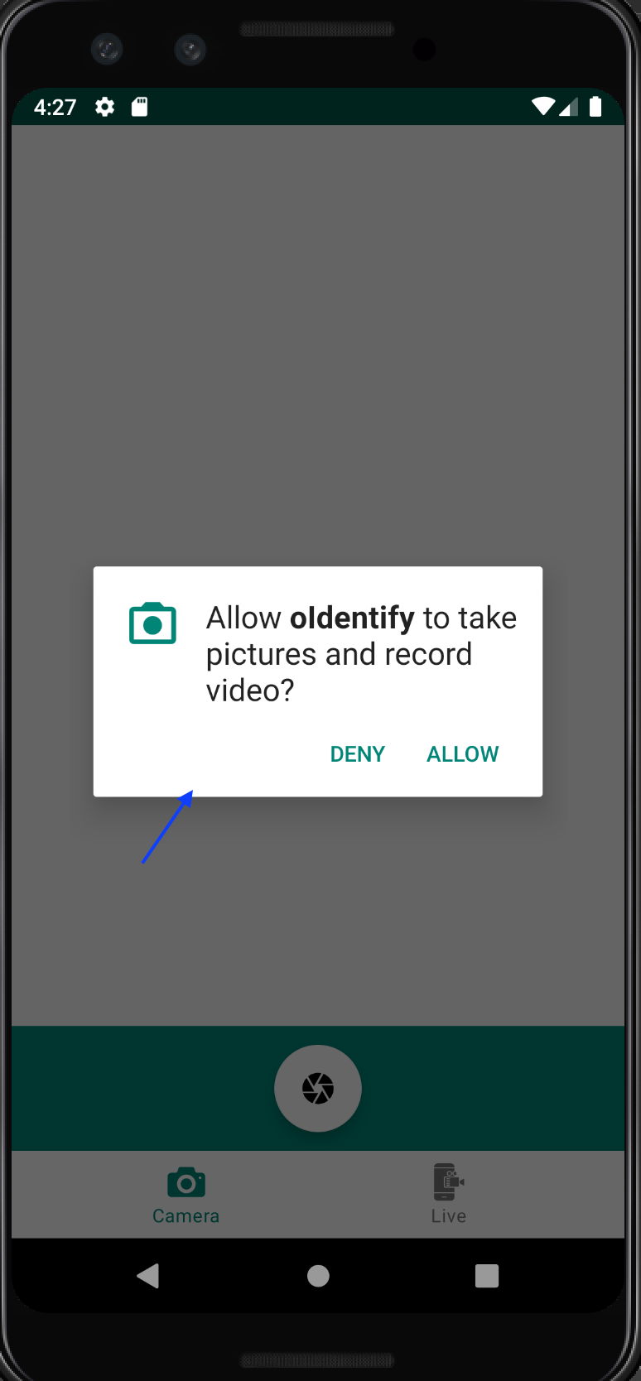
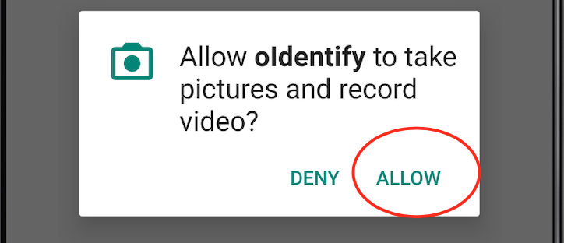
Giving app permission to open camera and allow to take pictures.
If the app is launched for the first time, we should allow this app to take pictures. A dialog box is displayed asking for those permissions. Just need a tap on Allow to provide the permissions.

Slide 33
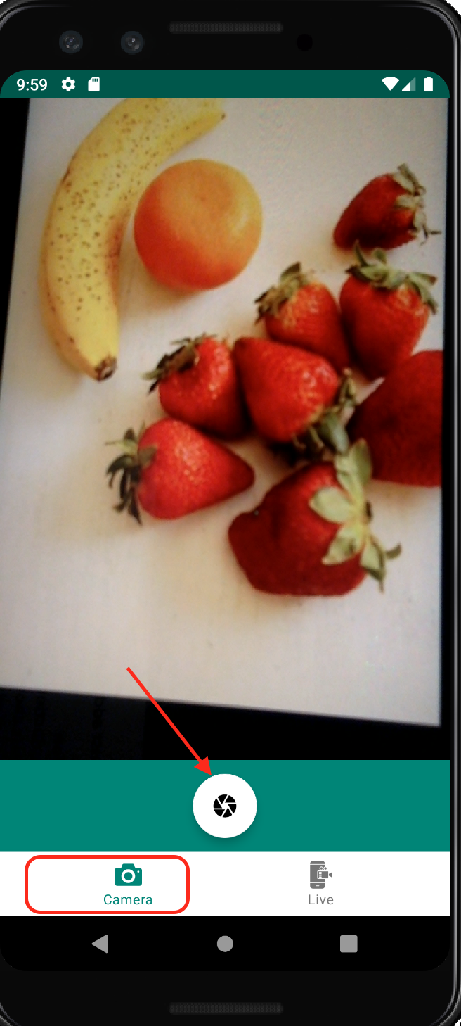
Capture fruits (object) image: This action can be performed by tapping on the capture icon in camera tab as show in the image below.

Slide 34
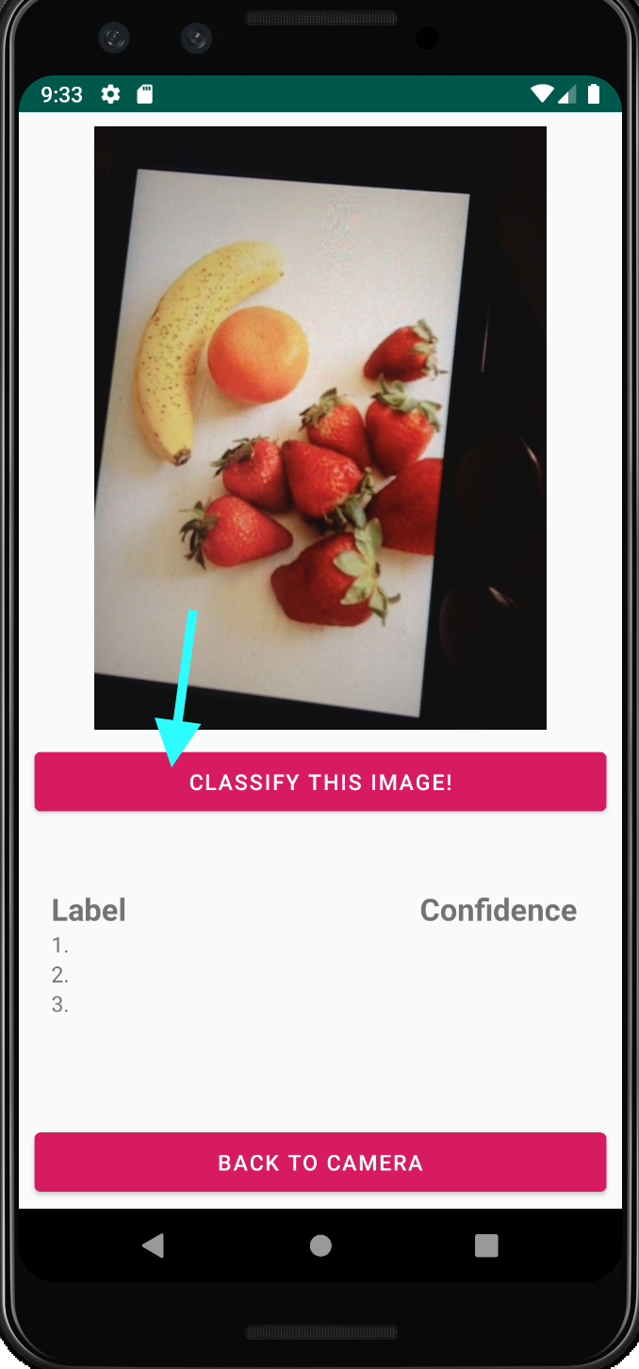
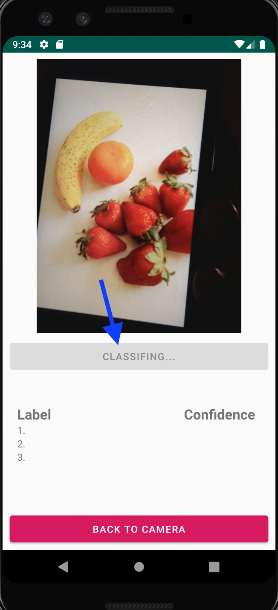
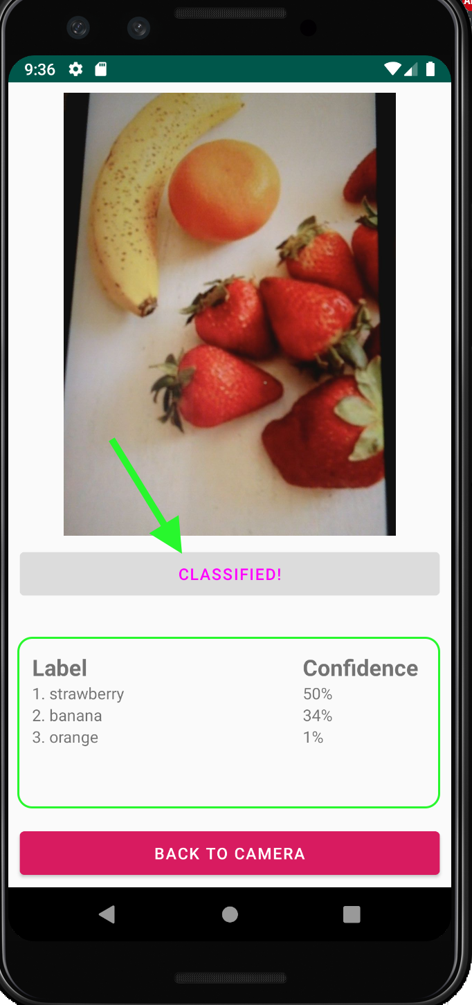
After allowing the permission to camera, we can now begin to identify objects.

Slide 35
Image on the left most: After taking image, we can now classify image to identify the objects by tapping on “CLASSIFY THIS IMAGE” button.
Image on the middle: After tapping the button, app takes few seconds to classify the objects in the image.
Image on the right most: After few seconds, we can see that image has been classified and objects been identified. For this demonstration, I have enable three images identification at a time (Number of object could be increased but in the code implementation only). Also, we can see Label and Confidence section in the image. Label shows the names of identified objects and Confidence shows the accuracy rate of that object been identified.

Slide 36
object Identification by live camera feed

Slide 37
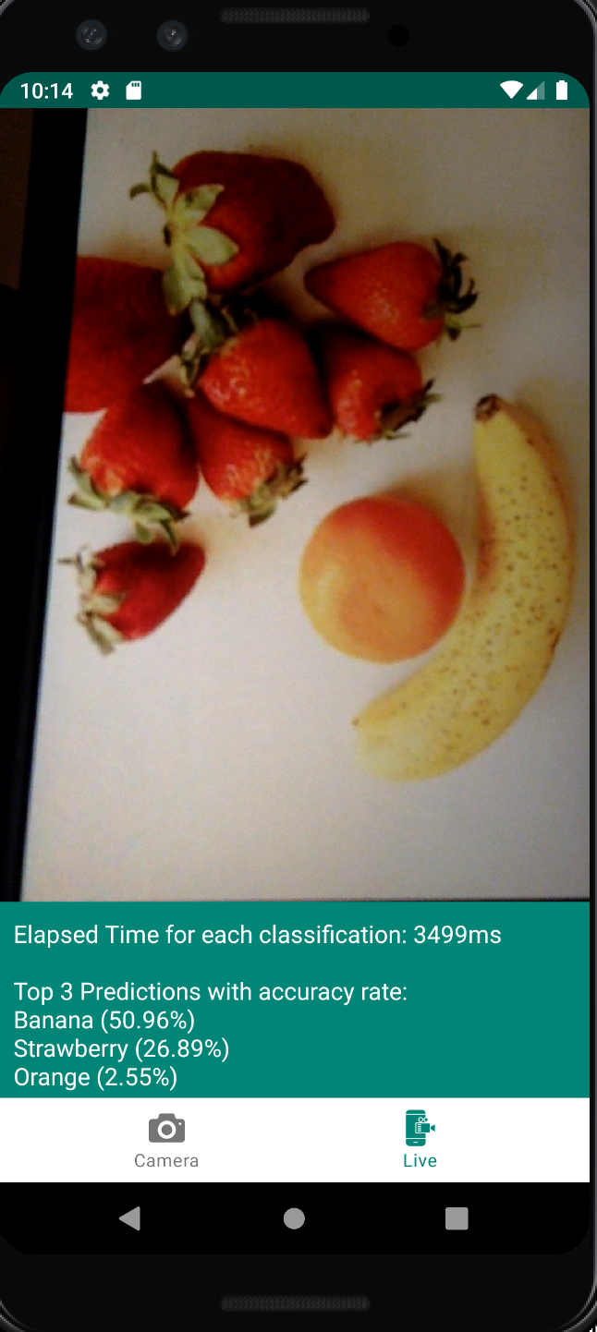
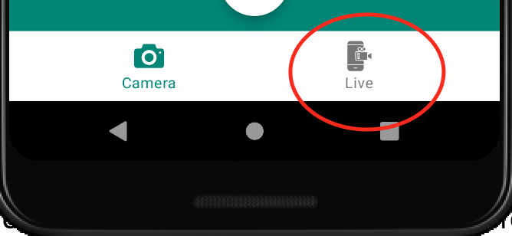
Previous demonstration could be also done by live camera -
-feed by going to Live tab.
Elapsed time for each classification give the time interval for -
- every identification process.
Also, we have three top predictions with their probability –
-accuracy rate.

Slide 38
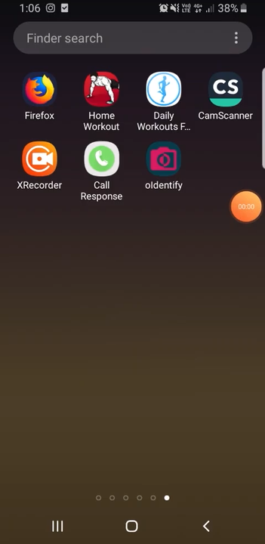
Video demonstration

Slide 39
Thank you! ☺

